Slide 1


Commission Meeting
December 2, 2020
1:15-3:30pm
We will all start the meeting on mute.
You will be unmuted every time there is time for public comment or discussion.
The chat box will monitored. Feel free to put questions or comments in that chat.
All votes must be done by roll call

Slide 2


Welcome and Introductions
Conflict of Interest Reminder for Commissioners and Alternates:
Commissioners with a direct financial interest (for themselves or their family members) shall recuse themselves from the decision on the proposal.
Commissioners who wish to recuse themselves for reason other than a financial interest (such as a possible perception of personal or professional bias for or against a proposal), may recuse themselves from the decision. Commissioners are asked to carefully evaluate this if there might be any problem with a quorum.
It is the Commission’s practice to ask individuals who are recusing themselves to leave the room while the proposal is being considered. If you recuse yourself, please remain available in the Superintendent of School’s seating area, outside of the conference room, so that you can be easily found to rejoin the meeting for subsequent agenda items.

Slide 3
Public Comment
The public may speak on any item not on the printed agenda. No action may be taken by the Commission. Public Comment is also taken on each agenda item.

Slide 4
Public Hearing on Annual Audit and Annual Report for FY 19/20
Audit
Annual Report
Discussion:
Public Comment:

Slide 5


Slide 6


Slide 7


Slide 8
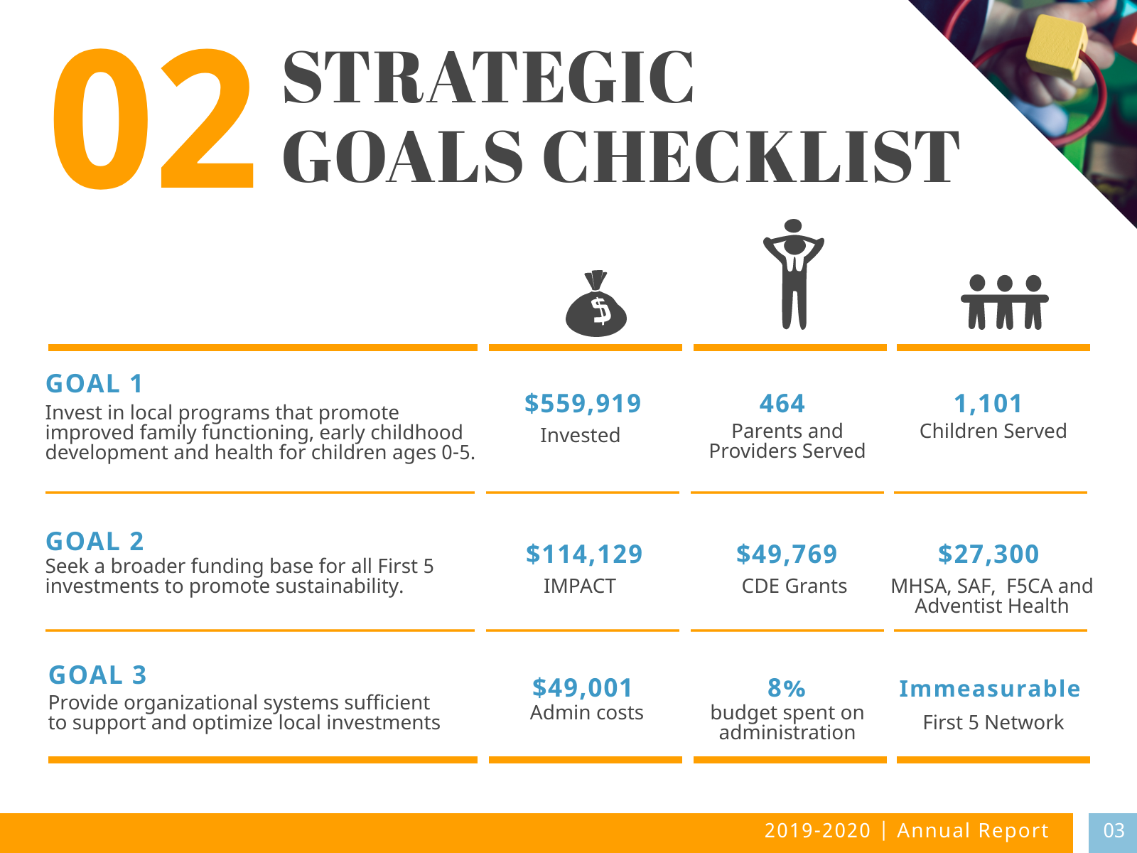

Slide 9
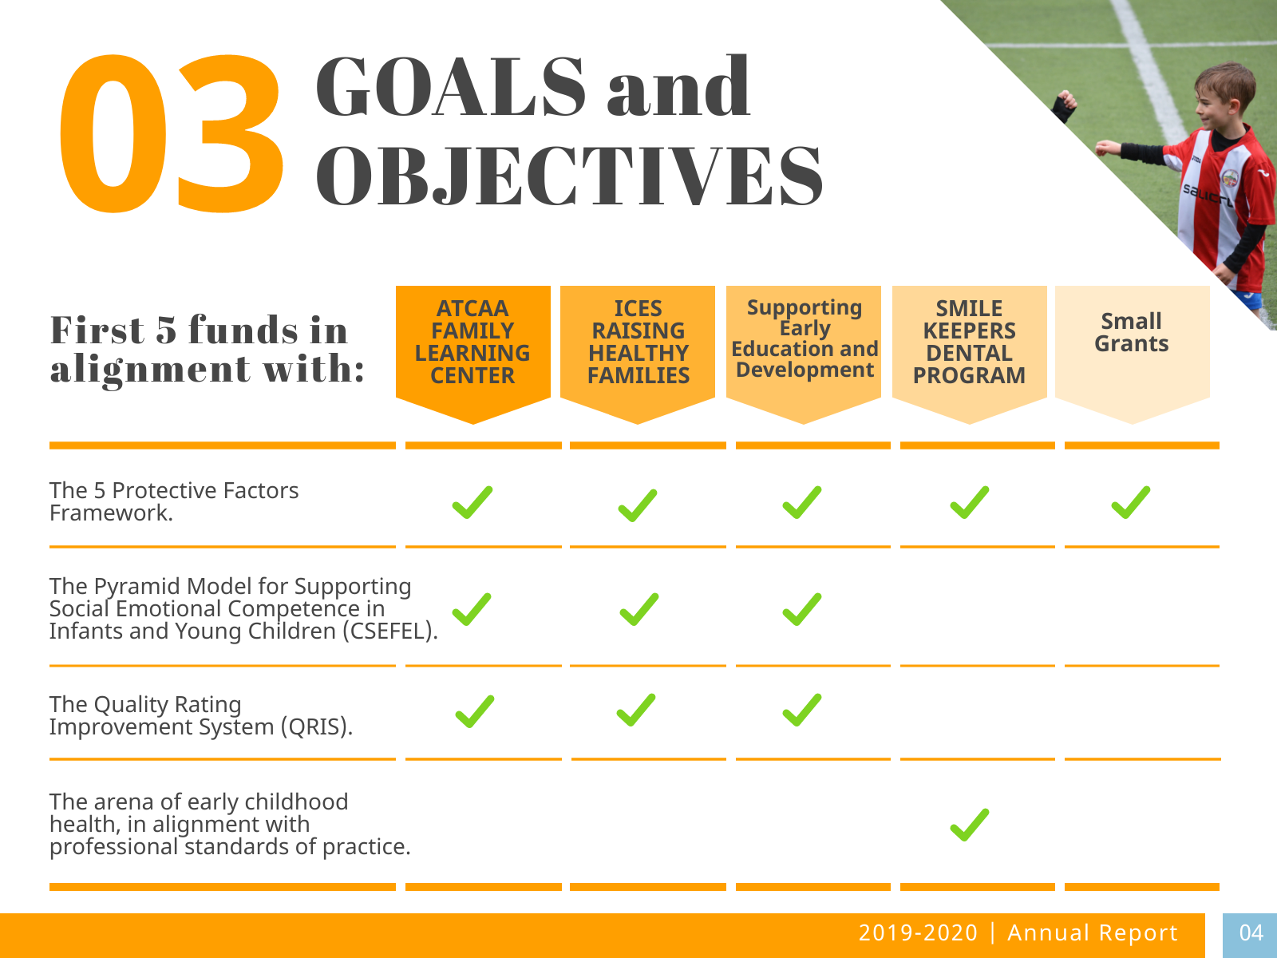

Slide 10


Slide 11


Slide 12


Slide 13
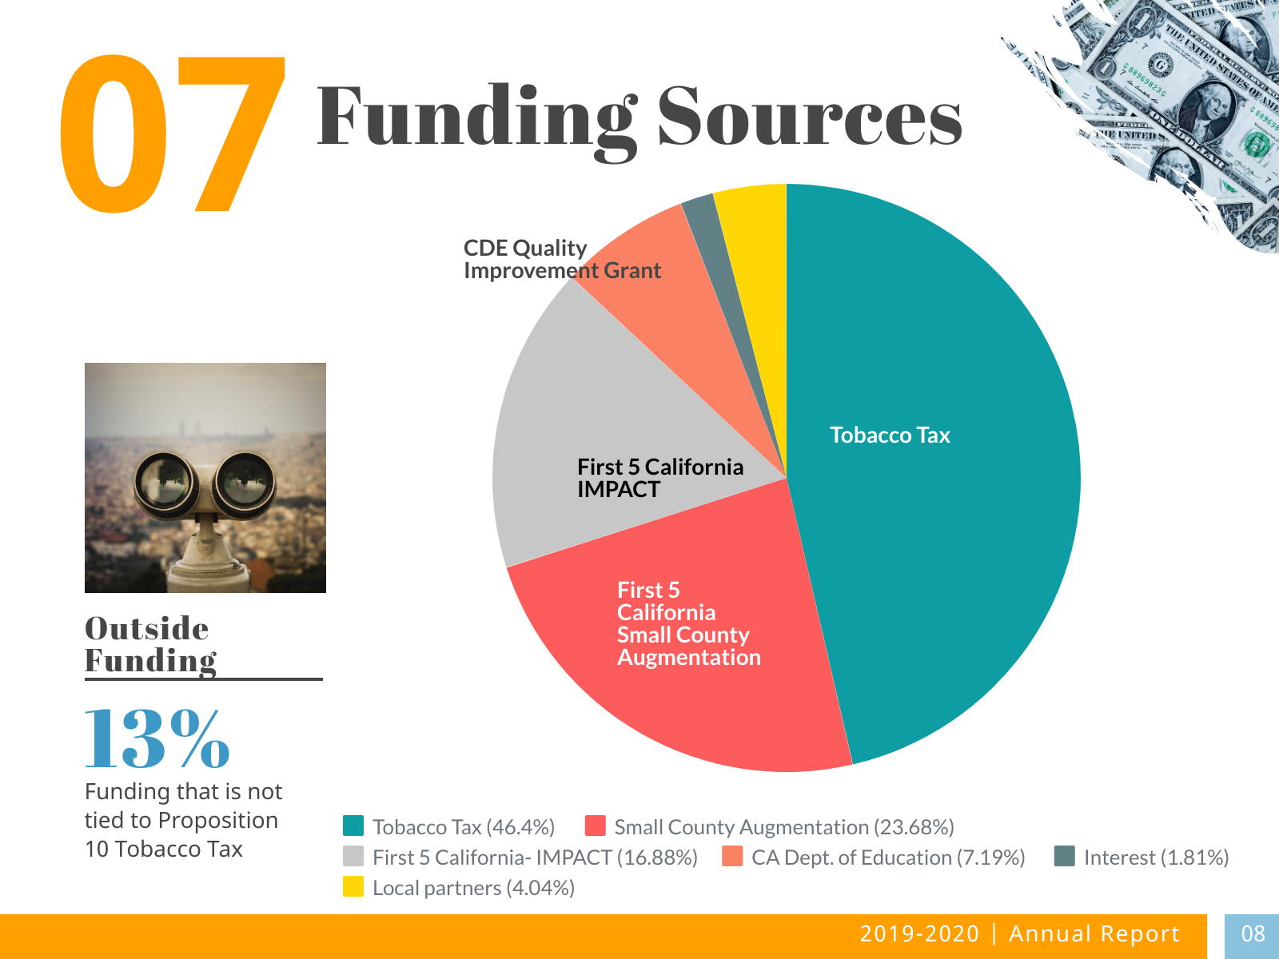

Slide 14


Slide 15


Slide 16


Slide 17


Slide 18
Public Hearing on Annual Audit and Annual Report for FY 19/20
Discussion:
Public Comment:

Slide 19
Item 1: Discussion and action to adopt Audit (attachment #1)
Suggested recusal: None
Action requested: Adopt 19/20 Audit

Slide 20
Item 2: Consider action to adopt Annual Report for FY 19/20
Suggested recusal: None
Action requested: Adopt 19/20 Annual Report

Slide 21
Item 3. Consider action to approve Minutes for October 2, 2020 (attachment #2)
Action requested:
Action requested: Approve the October 2, 2020 minutes as presented

Slide 22
Item 4. Monthly Financial Report through October 2020, (attachment #3)

Slide 23
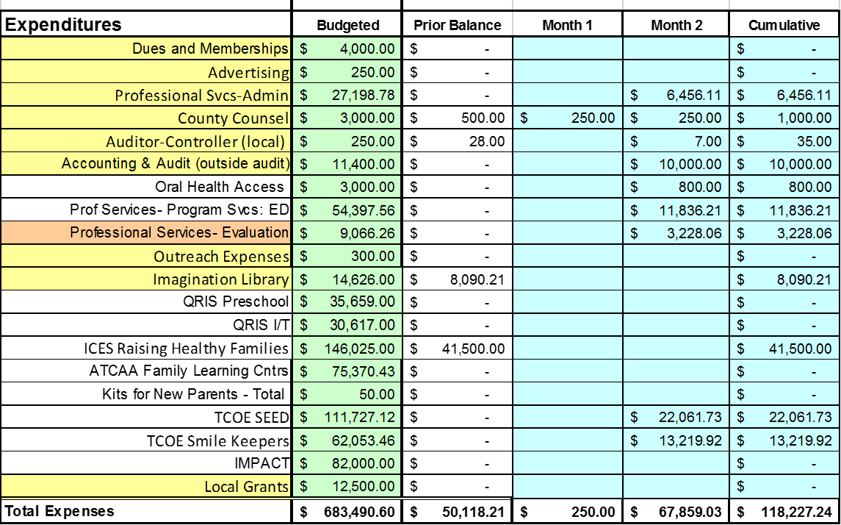

Slide 24
Discussion Items, Information Items and Reports
Item 5: Small Grants Update
Item 6: Reports from Executive Director, Commissioners and Ex-Officios
Time and location for next meeting:
December 2, 2020 at 1:15 pm
Location To Be Announced

